Slide 1
SuperScale: Image Upscaling
Laraib Akhtar 21L-5294
Qasim Naveed 21L-5231
Wajeeh Ahmad 21L-7565
Haseeb Zaheer 21L-5171

Slide 2
Problem Statement
Visual Quality: Low-resolution images lack detail and clarity, making them unsuitable for many applications.
Usability: Enhancing low-res images to high-definition improves their suitability for analysis, interpretation, and presentation.
Diverse Applications: Upscaling is crucial for medical imaging, surveillance, digital media, and more.

Slide 3
DataSet Info
DIV2K Dataset: A high-quality, diverse benchmark for image super-resolution.
Extensive Images: The dataset covers a wide range of scenes, objects, textures, and patterns.
Training & Testing: 500 images for training, 100 pairs held-out for evaluation.
Preprocessing: Augmentation, resizing, and batch processing to optimize model input.

Slide 4
Methodology GAN: Generative adversarial Network
Generator: Transforms low-res inputs into high-quality outputs.
Discriminator: Distinguishes real high-res images from generated ones.
Adversarial Loss: Encourages the generator to produce realistic, high-res images.

Slide 5
Preprocessing
Data Augmentation: Augment original images with random transformations to enrich dataset diversity.
Resizing and Formatting: Resize augmented images to 1500x1500 pixels for uniformity in batch processing.
Batch Processing: Organize images into batches of 16, optimizing computational efficiency.
Further Augmentation for Generalization: Apply additional random transformations to enhance model's adaptability to diverse image characteristics.

Slide 6
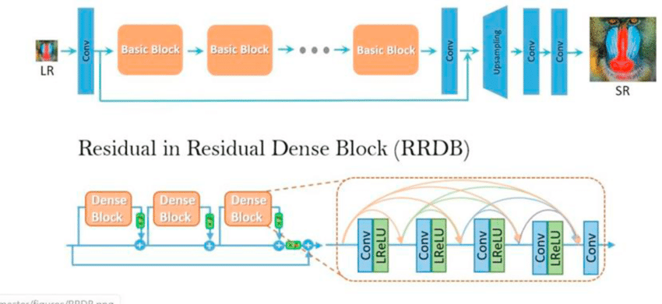
Model Information

Slide 7
Results
How our model compares to current competitors

Slide 8
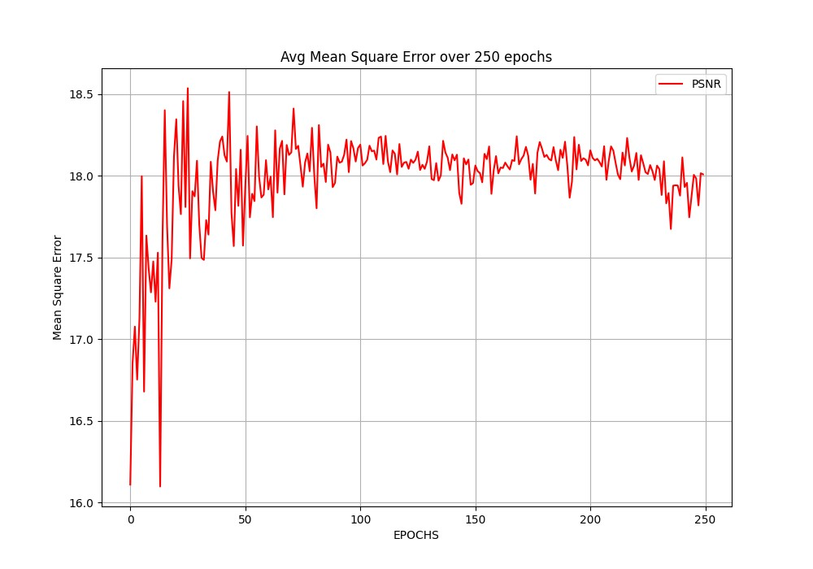
PSNR

Slide 9
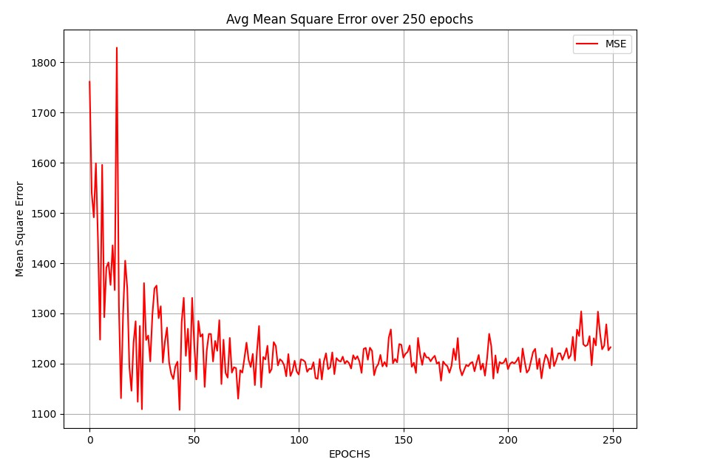
MSE

Slide 10
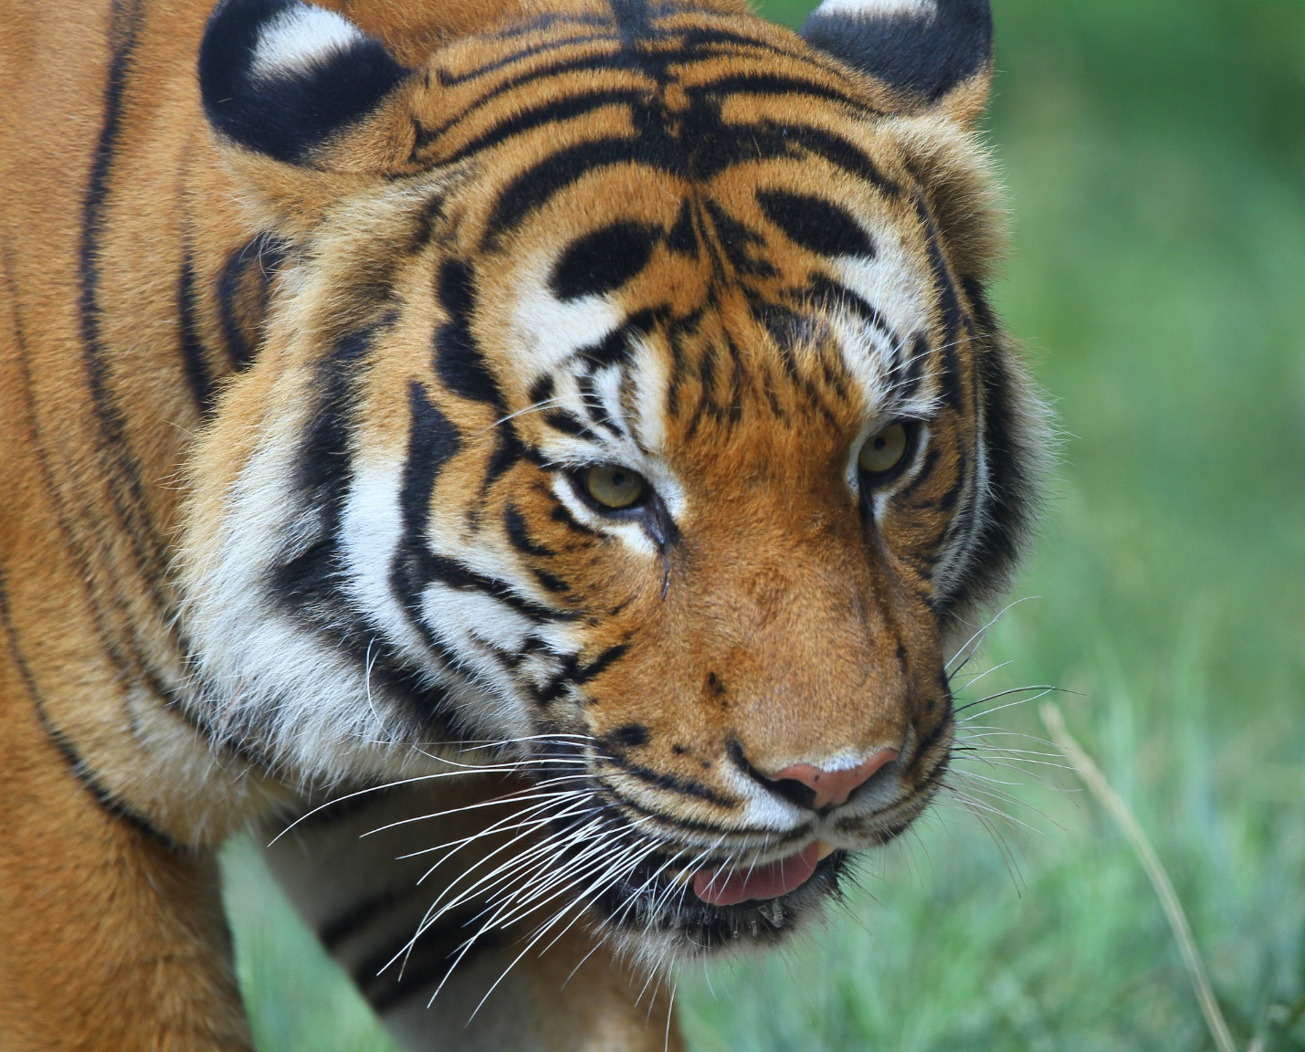
Desired Output

Slide 11
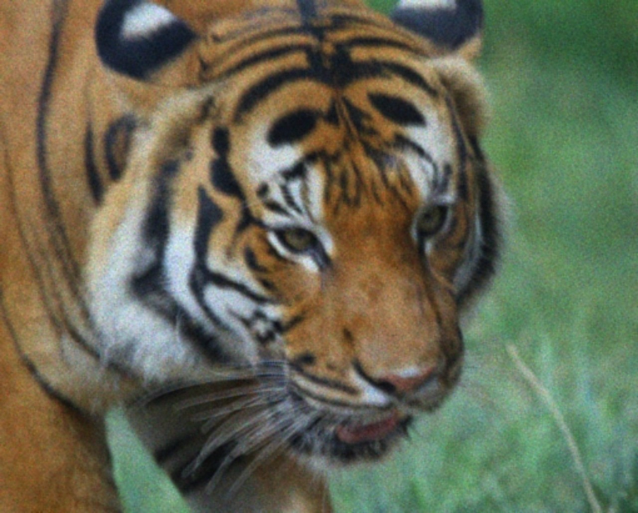
PRE-TRAINED ESRGAN

Slide 12

OpenCV

Slide 13

SuperScale (Epoch 120)

Slide 14
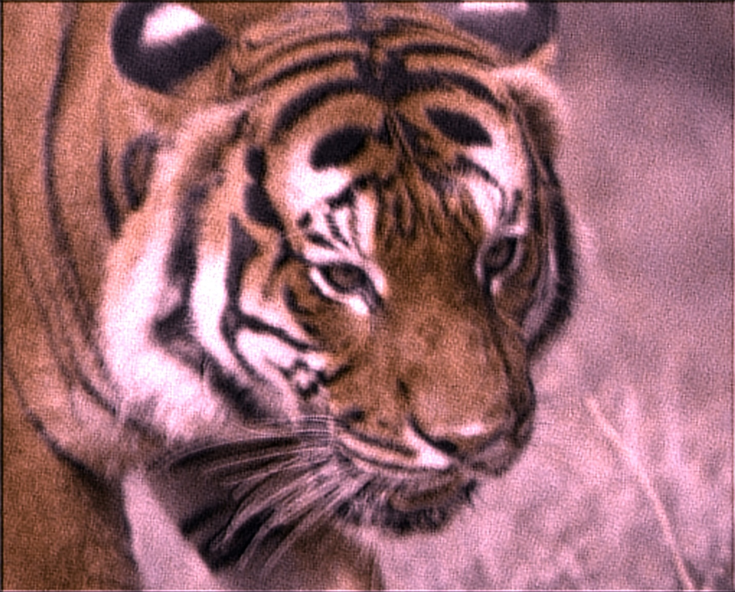

Epoch 1
Epoch 120
Epoch 250

Slide 15
Thank you

